Slide 1
data engines
must grok ‘em all

Slide 2
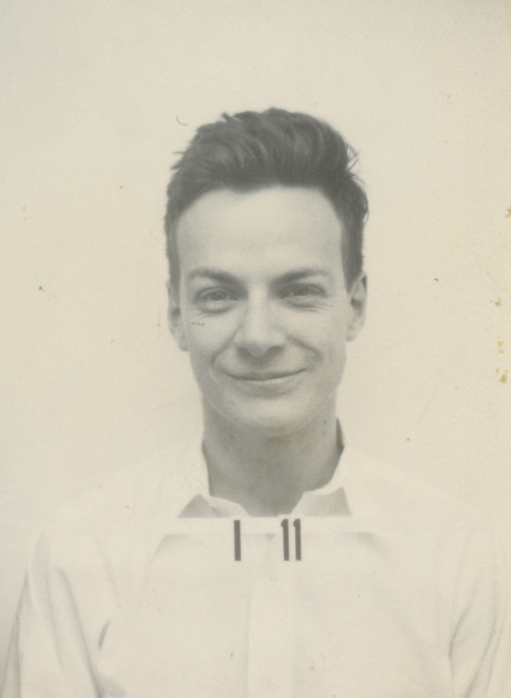
teach / learn
this dude
Notes:
https://commons.wikimedia.org/wiki/File:Feynman-richard_p.jpg?uselang=en#Licensing

Slide 3
teach / learn
it is hubris to think that anyone can come here and teach you
-Richard Feynman*
* (I think, I don’t know who, maybe someone else said it…)

Slide 4
teach / learn
no one can teach you

Slide 5
teach / learn
but you can learn

Slide 6
teach / learn
the best anyone can hope for is to inspire you to learn

Slide 7
teach / learn
that’s the only grace I aspire to today

Slide 8
one

Slide 9
PERCEPTION
PERCEPTION
PERCEPTION
PERCEPTION
PERCEPTION
PERCEPTION

Slide 10
PERCEPTION
become aware of something through the senses intuitive understanding,
insight
PERCEPTION
PERCEPTION
PERCEPTION
PERCEPTION
PERCEPTION

Slide 11
AESTHETIC
become aware of something through the senses intuitive understanding,
insight
TASTE
APPRECIATION
DISCERNMENT
perceptiveness
PERCEPTION

Slide 12
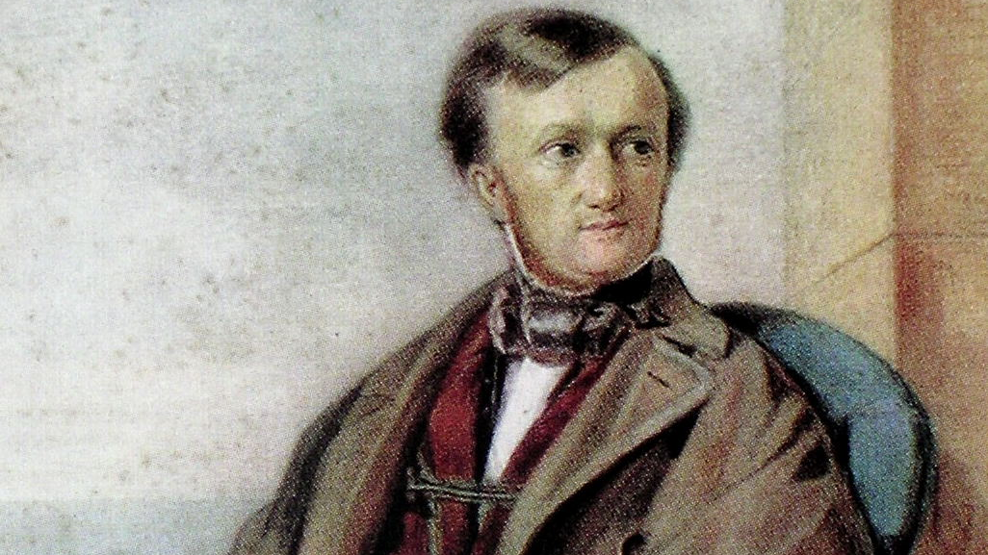

Slide 13
RICHARD WAGNER

Slide 14
1813 – 1883, GERMAN
RICHARD WAGNER
COMPOSER
CONDUCTOR
POLEMICIST*
THEATRE DIRECTOR

Slide 15
1813 – 1883, GERMAN
RICHARD WAGNER
operas, musical dramas, prose and letters
57 books of music
13 books of prose and stuff
12000 letters and counting!
„the tristan chord“, „the sound wall“, „father of heavy metal“

Slide 16
1813 – 1883, GERMAN
RICHARD WAGNER
writes
'The Artwork of the Future‘ in 1849
(Das Kunstwerk der Zukunft)

Slide 17
1813 – 1883, GERMAN
RICHARD WAGNER
writes
'The Artwork of the Future‘ in 1849
(Das Kunstwerk der Zukunft)
music + drama = art v2.0

Slide 18
1813 – 1883, GERMAN
RICHARD WAGNER
writes
'The Artwork of the Future‘ in 1849
(Das Kunstwerk der Zukunft)
VAUDEVILLE

Slide 19
1813 – 1883, GERMAN
RICHARD WAGNER
writes
'The Artwork of the Future‘ in 1849
(Das Kunstwerk der Zukunft)
VAUDEVILLE
PARSI THEATRE

Slide 20
1813 – 1883, GERMAN
RICHARD WAGNER
writes
'The Artwork of the Future‘ in 1849
(Das Kunstwerk der Zukunft)
VAUDEVILLE
PARSI THEATRE
BOLLYWOOD

Slide 21
also has some…
1813 – 1883, GERMAN
RACIST AND ANTISEMITIC THOUGHTS
RICHARD WAGNER
writes
'The Artwork of the Future‘ in 1849
(Das Kunstwerk der Zukunft)
VAUDEVILLE
PARSI THEATRE
BOLLYWOOD

Slide 22
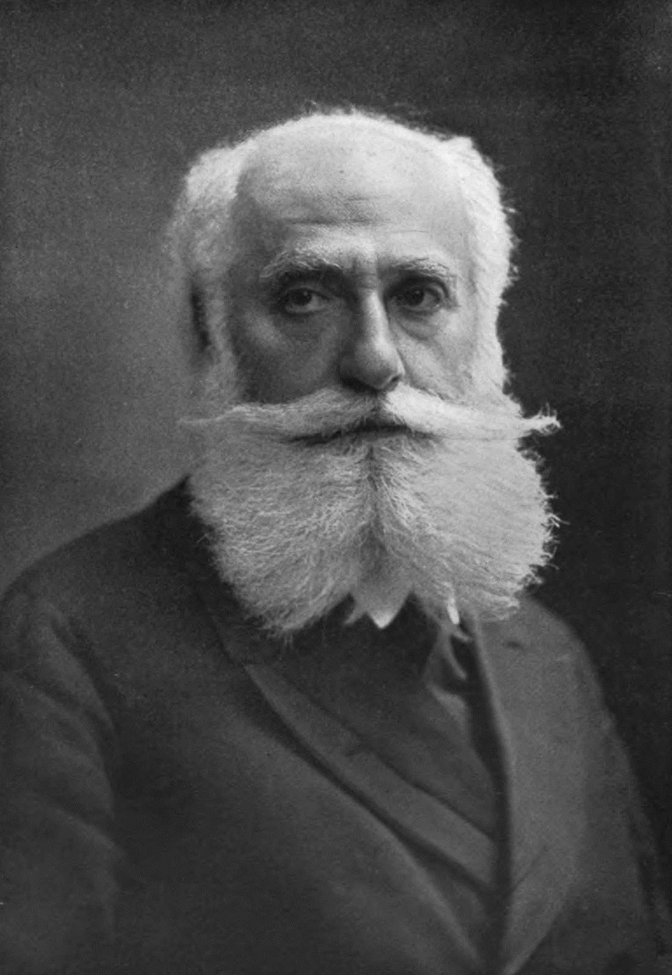
MAX NORDAU

Slide 23
1849 – 1923, AUSTRIA/HUNGARY
MAX NORDAU
SOCIAL CRITIC*
PHYSICIAN
ZIONIST*
AUTHOR

Slide 24
…MUST. COMB. BEARD.
1849 – 1923, AUSTRIA/HUNGARY
MAX NORDAU
the good parts in his writing seem derivative, unoriginal – remixing Marx and Bakunin

Slide 25
1849 – 1923, AUSTRIA/HUNGARY
MAX NORDAU
also wrote
“Entartung” or “DEGENERATION” in 1892

Slide 26
1849 – 1923, AUSTRIA/HUNGARY
MAX NORDAU
also wrote
“Entartung” or “DEGENERATION” in 1892
a summary of Entartung:
all these kids don’t know anything
society is decaying
morals are going down
errything’s gone to sh*t…
also Wagner is bad bad BAD

Slide 27
1849 – 1923, AUSTRIA/HUNGARY
MAX NORDAU
also wrote
“Entartung” or “DEGENERATION” in 1892
Wagner exhibited signs of psychological and moral degeneration.

Slide 28
1849 – 1923, AUSTRIA/HUNGARY
MAX NORDAU
also wrote
“Entartung” or “DEGENERATION” in 1892
Wagner exhibited signs of psychological and moral degeneration.
…departure from classical harmony and order.

Slide 29
1849 – 1923, AUSTRIA/HUNGARY
MAX NORDAU
also wrote
“Entartung” or “DEGENERATION” in 1892
Wagner exhibited signs of psychological and moral degeneration.
…departure from classical harmony and order.
…deep emotional experiences promoted irrationality…

Slide 30
1849 – 1923, AUSTRIA/HUNGARY
MAX NORDAU
also wrote
“Entartung” or “DEGENERATION” in 1892
Wagner exhibited signs of psychological and moral degeneration.
…departure from classical harmony and order.
…deep emotional experiences promoted irrationality…
…Wagner's operas divert attention from social progress and rational thought…
Notes:
This is the time when it takes tremendous privilege and access to be educated, even more to be a published author.
All the people we hear about – Oppenheimer, Einstein, Schrödinger, and who ever else, we all people of privilege, who had the time to dedicate to deep study and not go about trying to earn a living.
So, when someone like Nordau – who is politically active and privileged writes two volumes – people paid attention.

Slide 31
1849 – 1923, AUSTRIA/HUNGARY
MAX NORDAU
also wrote
“Entartung” or “DEGENERATION” in 1892
This was obviously DUMB™
If the world worked like that, we wouldn’t get movies, songs, literature, computers, cars, medicine...
How could Nordau be so misguided?*
* stop thinking about the beard, answer the question!!!

Slide 32
1849 – 1923, AUSTRIA/HUNGARY
MAX NORDAU
also wrote
“Entartung” or “DEGENERATION” in 1892
Maybe he saw only half the picture?

Slide 33
What’s more $$$ ?
Option 1: Caves>Stay In Caves>Why change?>Abolish all change> Caves are our culture>Caves and combing beards.
Option 2: Caves>What’s that outside>Wait you can do that?>Wow that too?>What else can we do?>Keep looking…
1849 – 1923, AUSTRIA/HUNGARY
MAX NORDAU
“DEGENERATION”
“new sh*t has come to light, man…”
-The Dude, The Big Lebowski (1998)
Evolution

Slide 34
Option 2 obvs!
Our brains are hardwired to seek the “NEW”.
Instagram reels, YouTube, Socials…
Data supports Option 2
1849 – 1923, AUSTRIA/HUNGARY
MAX NORDAU
“DEGENERATION”
“new sh*t has come to light, man…”
-The Dude, The Big Lebowski (1998)
Evolution

Slide 35
in seeking
“the glory of the former days”,
Our friend Mr. Chin-Curtain,
lost his ability of
1849 – 1923, AUSTRIA/HUNGARY
MAX NORDAU
TASTE
AESTHETIC
“DEGENERATION”
APPRECIATION
DISCERNMENT
perceptiveness
PERCEPTION
“new sh*t has come to light, man…”
-The Dude, The Big Lebowski (1998)

Slide 36
CC had the intellect, the access and the privilege, but did not have the PERCEPTION to really understand or appreciate the music.
1849 – 1923, AUSTRIA/HUNGARY
MAX NORDAU
TASTE
AESTHETIC
“DEGENERATION”
APPRECIATION
DISCERNMENT
perceptiveness
PERCEPTION
Every generation thinks the younger ones’ musical choices are circumspect. It has never been the case.

Slide 37
Wagner inspired Vaudeville in US and UK, Parsi Theatre in India
Parsi Theatre inspired songs in our films.
Our films are unique in the world because of Wagner’s
1849 – 1923, AUSTRIA/HUNGARY
MAX NORDAU
TASTE
AESTHETIC
“DEGENERATION”
APPRECIATION
DISCERNMENT
perceptiveness
PERCEPTION
Imagine what we would be had we thought like Nordau...

Slide 38
"The unexamined life is not worth living"
- Socrates, 399 BC
TASTE
AESTHETIC
APPRECIATION
DISCERNMENT
perceptiveness
PERCEPTION

Slide 39
sans evolving perception
we stop enjoying things (new music for e.g.)
we stop caring
ennui
TASTE
AESTHETIC
APPRECIATION
DISCERNMENT
perceptiveness
PERCEPTION

Slide 40
less bored, less boring – how?
the French have this concept called
RAFFINÉ
TASTE
AESTHETIC
APPRECIATION
DISCERNMENT
perceptiveness
PERCEPTION

Slide 41
RAFFINÉ
learn a bit more, makes you interested a bit more, and so you learn a bit more and on and on, thus you “refine”
interested === interesting
* notice the triple = sign, if you know you know
TASTE
AESTHETIC
APPRECIATION
DISCERNMENT
perceptiveness
PERCEPTION

Slide 42
RAFFINÉ
learn a bit more, makes you interested a bit more, and so you learn a bit more and on and on, thus you “refine”
interested === interesting
* notice the triple = sign, if you know you know
TASTE
AESTHETIC
APPRECIATION
DISCERNMENT
perceptiveness
‘nuff said

Slide 43
two

Slide 44
we always hear
"Tech's changing so fast, it's hard to keep up..."

Slide 45
love the sea, not the boat
IMO, if you stay interested, it’s never hard

Slide 46
love the sea, not the boat
let’s see inside an engine
see how it works

Slide 47
how it works
a quick decision tree

Slide 48
decision tree
Data Engine
Compute
Storage
Interface

Slide 49
decision tree
Data Engine
Compute
Storage
Interface
Is Compute and Storage Decoupled? (faster and cheaper at scale)
Vectorized? Distributed?
SQL or other?
How does it handle Metadata?

Slide 50
decision tree
Data Engine
Compute
Storage
Interface
Is Compute and Storage Decoupled? (faster and cheaper at scale)
Vectorized? Distributed?
SQL or other?
How does it handle Metadata?
NUMA aware, SIMD (Flynn’s classification) In-memory representation
Separate Store and Compute prove faster and cheaper at scale in most cases
Row-wise or Columnar representation
SQL, PRQL, Substrait, others
JIT compiled? Pre-compiled?

Slide 51
decision tree – breaks the ice, not comprehensive
we could talk about batch vs streaming, structured and unstructured data, json or tables, logs, replication yada yada… we could write our own engine… all in due time.
Data Engine
Compute
Storage
Interface
Is Compute and Storage Decoupled? (faster and cheaper at scale)
Vectorized? Distributed?
SQL or other?
How does it handle Metadata?
NUMA aware, SIMD (Flynn’s classification) In-memory representation
Separate Store and Compute prove faster and cheaper at scale in most cases
Row-wise or Columnar representation
SQL, PRQL, Substrait, others
JIT compiled? Pre-compiled?

Slide 52
Pandas
Data Engine
Compute
Storage
Interface
Is Compute and Storage Decoupled? (faster and cheaper at scale)
Vectorized? Distributed?
SQL or other?
How does it handle Metadata?
SIMD but not distributed Row-wise (Numpy) vectorized Columnar (Arrow) vectorized
Separate Store and Compute – can load data and save data to varied stores
Row-wise (Numpy), new version also has support for Arrow (Columnar) representation
No built-in isolation for metadata
Pandas data frames and indexes
Python based execution

Slide 53
Postgres
Data Engine
Compute
Storage
Interface
Is Compute and Storage Decoupled? (faster and cheaper at scale)
Vectorized? Distributed?
SQL or other?
How does it handle Metadata?
SIMD but not distributed Row-wise
Unclear if it’s vectorized yet
Store and Compute not separate
Row-wise representation
Metadata: pg_catalog, information_schema
SQL (specific flavor)

Slide 54
Apache Spark
Data Engine
Compute
Storage
Interface
Is Compute and Storage Decoupled? (faster and cheaper at scale)
Vectorized? Distributed?
SQL or other?
How does it handle Metadata?
SIMD, distributed Row-wise Photon, Velox supports vectorized execution
Store and Compute completely separate
Row-wise representation, can handle columnar storage (but not compute) through Parquet, hybrid through Iceberg
Spark Catalogue handles Metadata (who knows about the _spark_metadata directory?) Parquet supports custom metadata.
SparkSQL, Spark Dataframes, RDD

Slide 55
Velox
Data Engine
Compute
Storage
Interface
Is Compute and Storage Decoupled? (faster and cheaper at scale)
Vectorized? Distributed?
SQL or other?
How does it handle Metadata?
SIMD, distributed Columnar (?) Vectorized execution
Just an execution engine, depends on connectors for this stuff, incl. Metadata
in-memory catalog to cache metadata
Connector dependent

Slide 56
highlights - easy rubric
lazy / eager execution
scalar / vector operations
data representation in memory (row-wise / columnar)
data representation on disk (row-wise / columnar)
task scheduling, optimization considerations
how 'poly' does the ecosystem get? - underlying complexities

Slide 57
how it works
inside a data engine

Slide 58
what any engine looks like
Storage and I/O
Query Parser (string to AST or DAG)
Query Plan Generator (aka Logical Plan)
Query Plan Optimizer
Execution Plan Generator (aka Physical Plan)
Execution Engine

Slide 59
what any engine looks like
All engines have some version of these components
Postgres, MySQL, Pandas, Numpy, Spark, Athena, Presto/Trino, Dask, Polars, Cassandra, DuckDB, Arrow, Velox, Ray, Photon and on and on …
Velox and Photon are just execution engines, but we’ll talk about that later.

Slide 60
big 4 out of 6
Parser
Analyzes the token stream to create a structured representation of the query's syntax (Abstract Syntax Tree – AST or Directed Acyclic Graph – DAG)
Query Planner / Optimizer
Transforms the AST/DAG into an optimized execution plan that outlines how the query will be processed.
Execution Engine
Executes the optimized physical plan to produce the query results.
Tokenizer
Splits the input query string into a sequence of tokens (keywords, identifiers, operators, literals).

Slide 61
big 4 out of 6 - details
Parser
parse(): Builds the AST or DAG from tokens.
Query Planner / Optimizer
build_plan(): Initial logical plan from AST.
Execution Engine
Operators: Perform tasks (e.g., scan, filter, join).
Tokenizer
tokenize(): Splits input string into a list of tokens.
Keyword Recognition: Identifies keywords (e.g. SELECT, WHERE, JOIN).
Literal Parsing: Handles numeric, string, and other literal values.
Clause Parsers: Handle specific query clauses (SELECT, FROM, WHERE, GROUP BY, etc.).
Grammar Rules: Defines the valid syntax of the query language.
Optimize: Apply transformations & estimate costs (e.g. predicate pushdown, join reordering).
Enumerate: Explore alternatives for best plan.
Pipeline: Operators in sequence.
Memory: Manages intermediate results.
Parallel: Coordinates parallel execution.

Slide 62
how it works
representing data in memory (or disk)

Slide 63
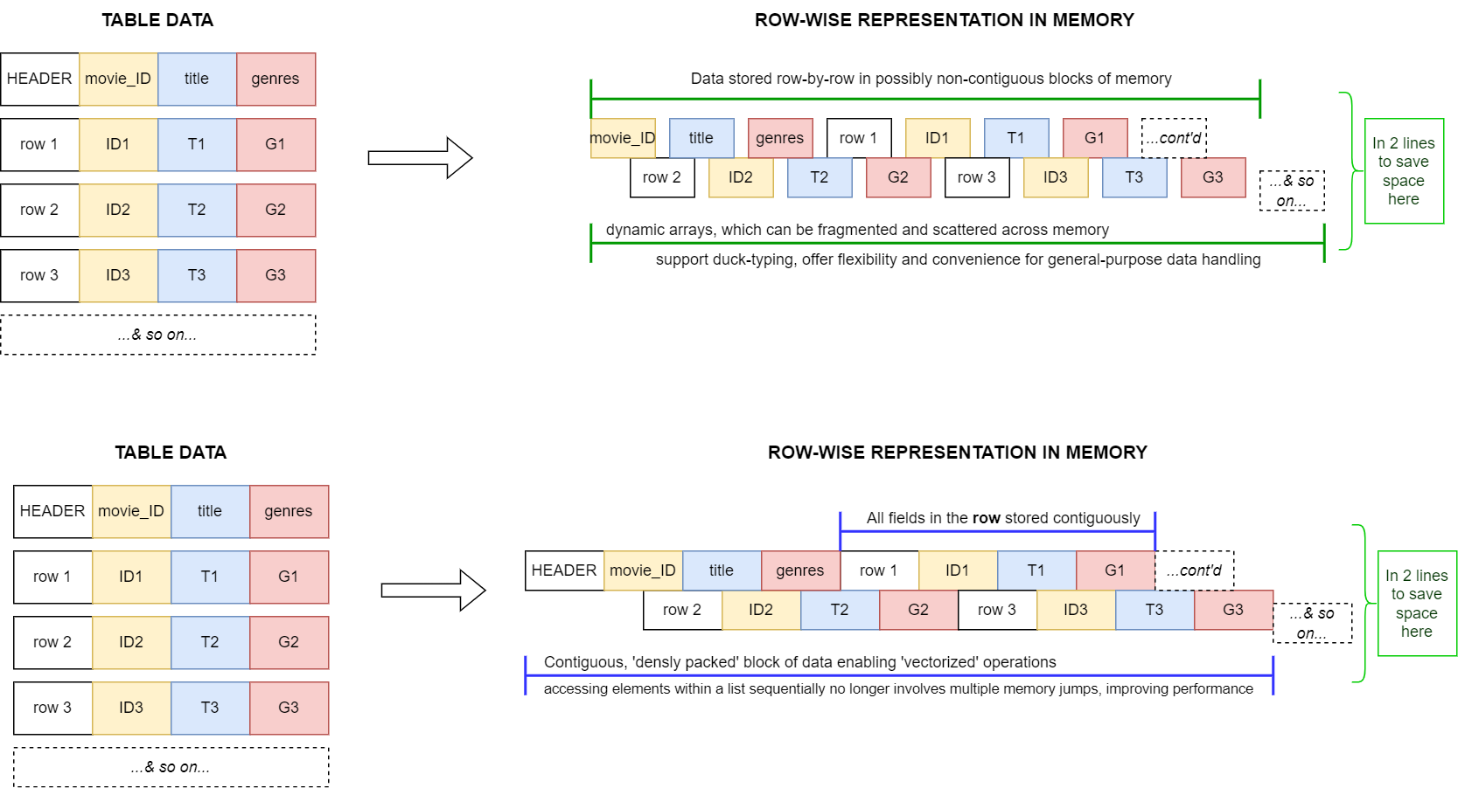
row by row representation

Slide 64
contiguous row by row representation

Slide 65
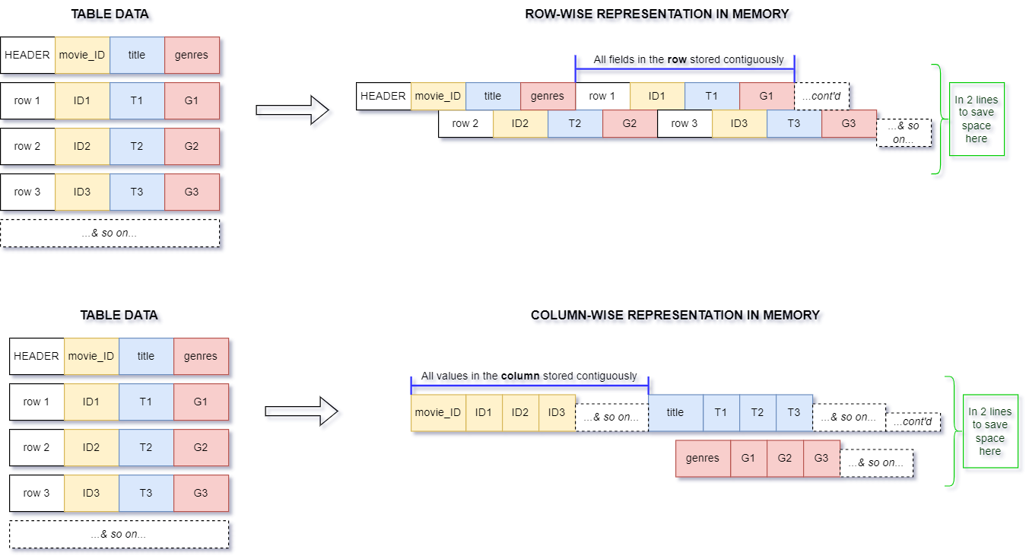
what’s columnar? – only load the columns you need - PING

Slide 66
what’s columnar? – only load the columns you need - PONG

Slide 67
wait a minute…
all that means we can kinda have…

Slide 68
that means we can kinda have…
A framework to build our own data engine
and evaluate other engines…

Slide 69
is that really it?
yes! *
*let's look at some code

